Slide 1
Handwritten Mathematical Expression Recognition for Automated Grading
Camila Moran-Hidalgo and Sarah Bentley

Slide 2
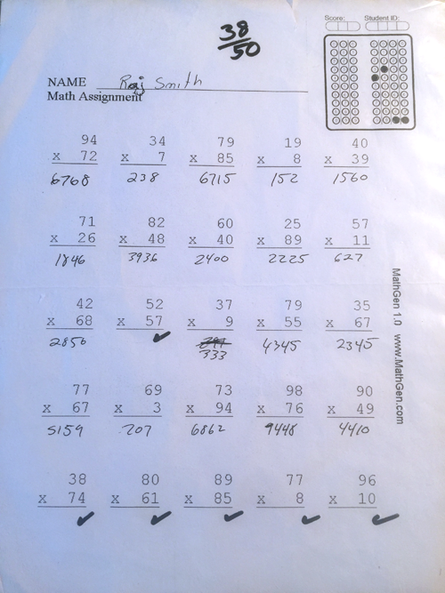
Motivation
Studies show that students benefit greatly from receiving feedback
However, teachers are over-burdened with grading, spending a median of 5 hours a week on it on top of many other tasks
We would like to use computer vision to recognize student math answers, specifically handwritten math equations
One step towards fully automated grading
Notes:
Camila
Why address HMER? It has been shown that students benefit greatly from receiving feedback on their work.
For instance, when introductory calculus students were quizzed regularly, it was found that 68% of them received a grade above a C whereas only 48% of the control group did.
Unfortunately, opportunities for feedback are often limited due to the instructor's limited capacity for grading. This is because manual grading must be done by individually interpreting each handwritten answer even if most of the answers are the same.
We aim to alleviate this issue by leveraging computer vision to recognize equal handwritten equations.
This would allow instructors to grade faster by grading equal answers simultaneously.

Slide 3
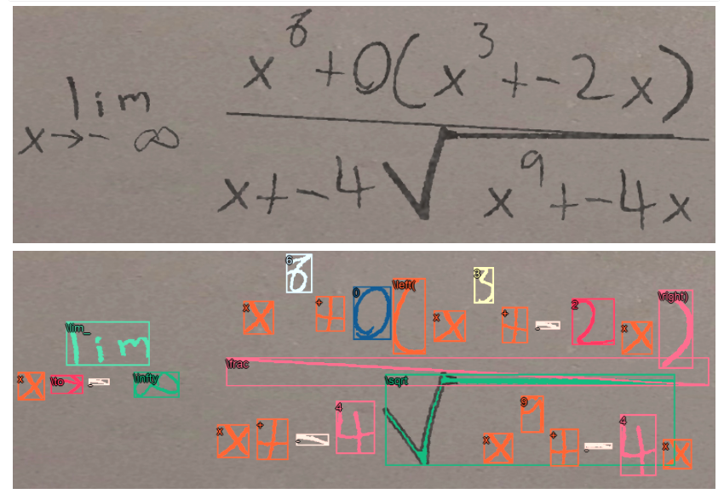
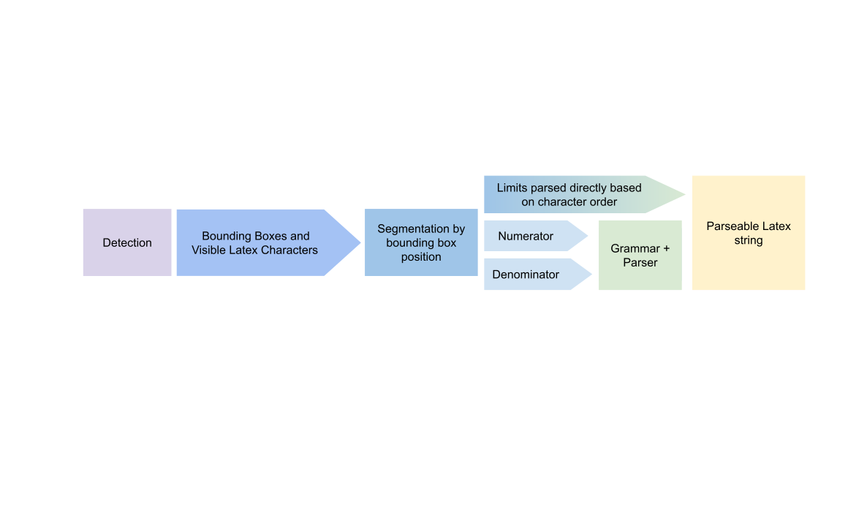
Methodology
Dataset: Aida Calculus Math Handwriting Recognition Dataset
Detection using the YOLO.v8 Model
Localizes & Classifies characters
Pre-trained on COCO
36 epochs
imgsz = 256
Transcription
Notes:
Sarah

Slide 4
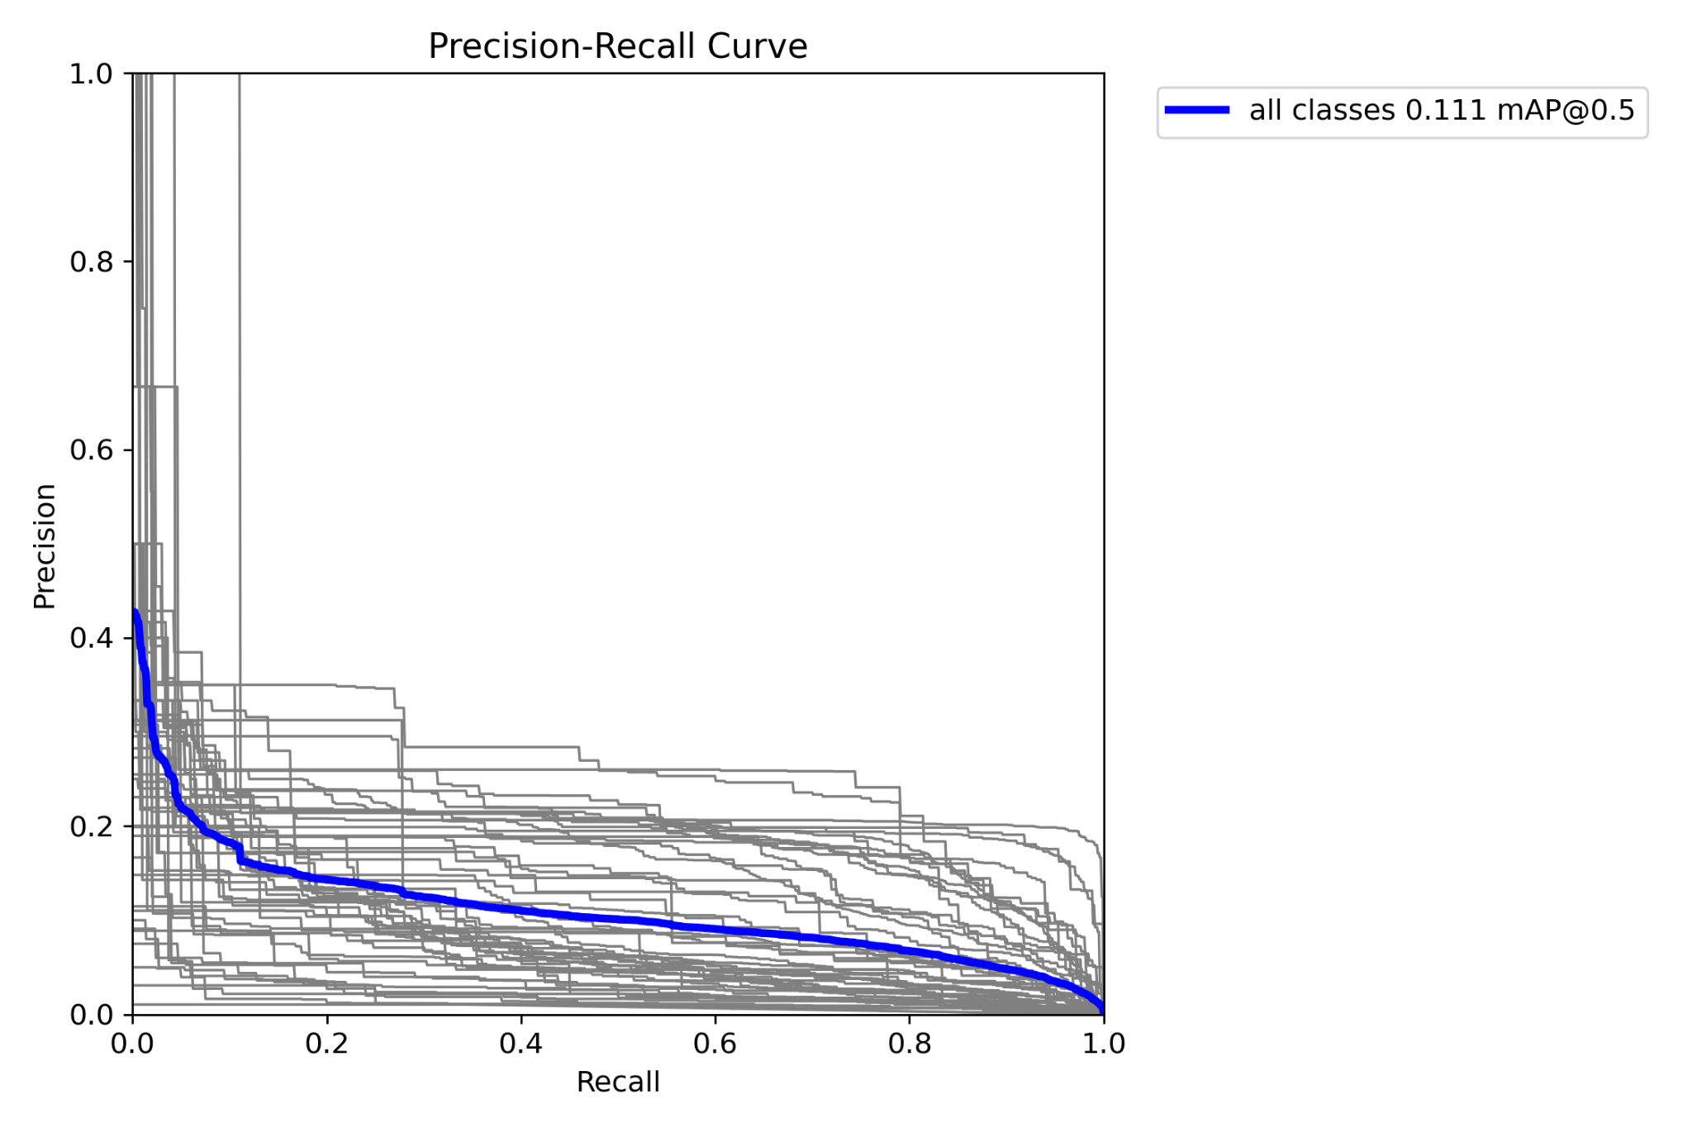
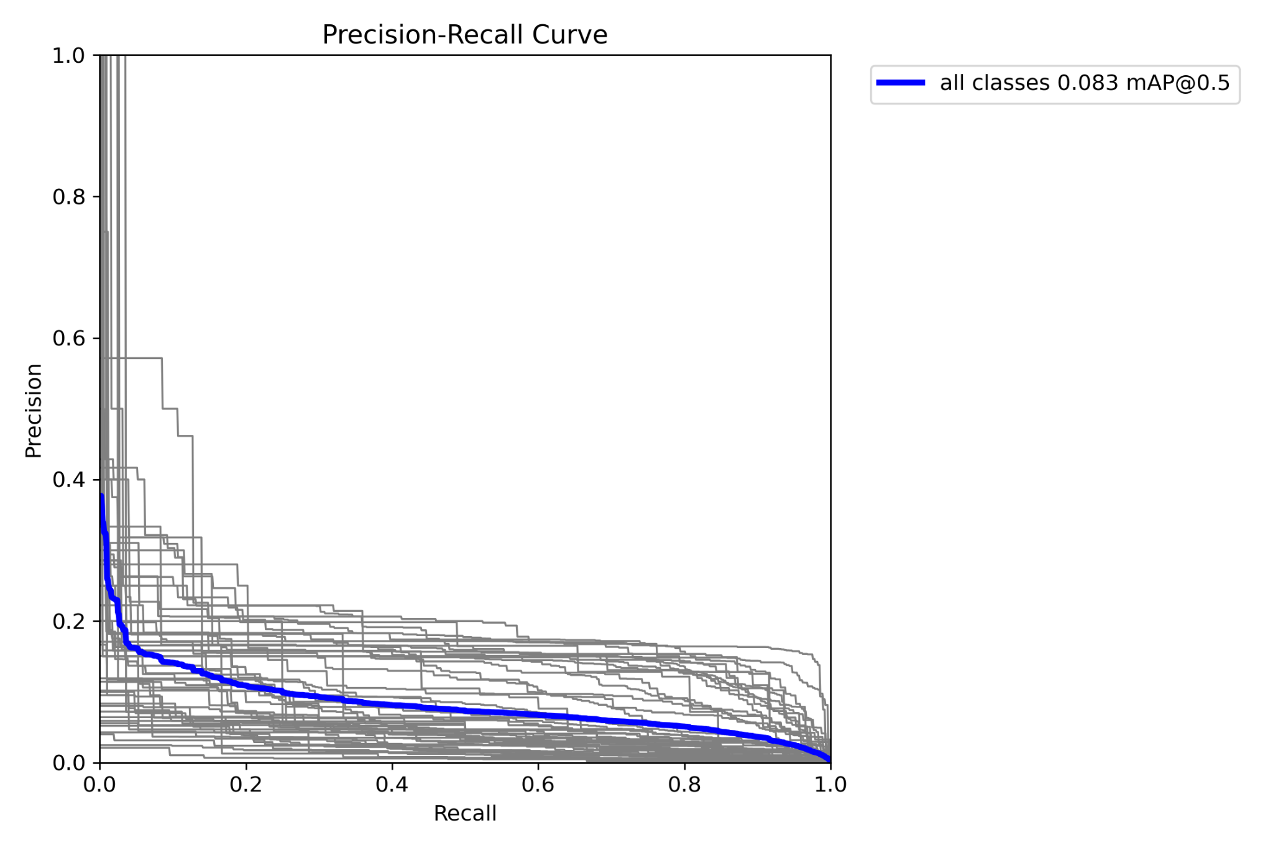
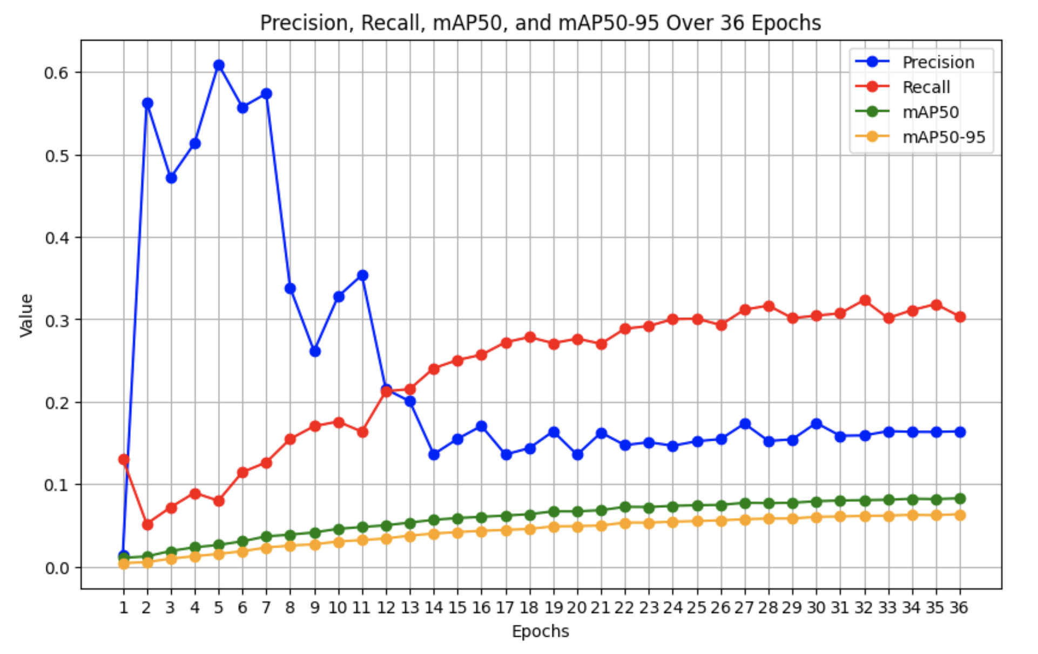
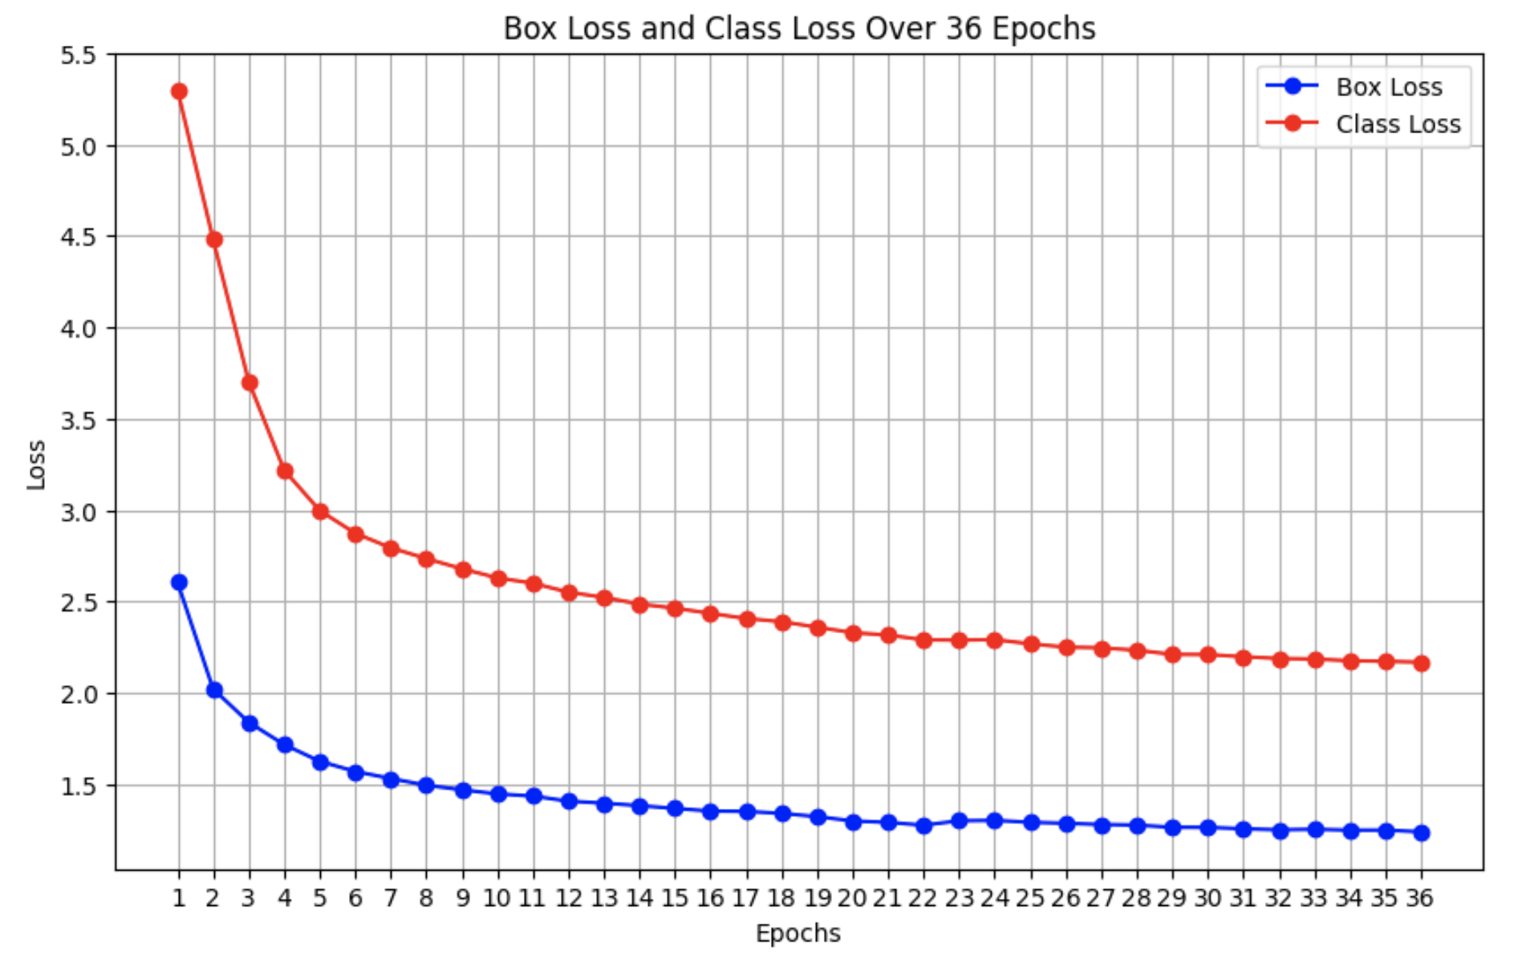
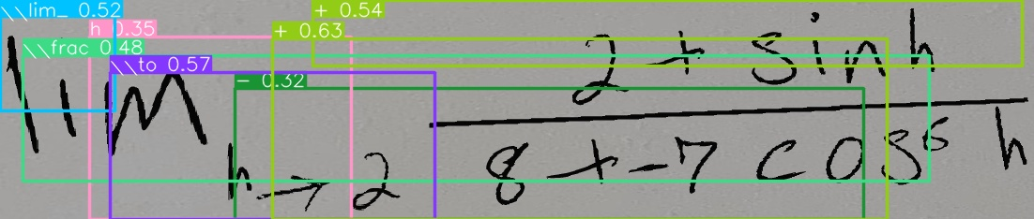
Results: Detection
Limited by lack of computational power
Validation mAP50 = 0.083
PR remains low
Exponential decrease in loss
Consistent, but slowing improvements in mAP
Test mAP50 = 0.111
PR remains low

Slide 5
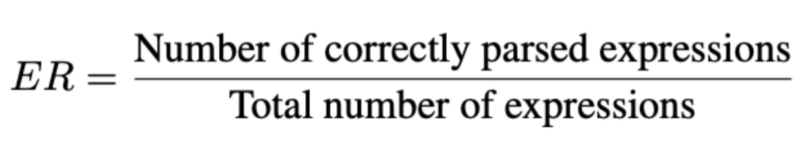
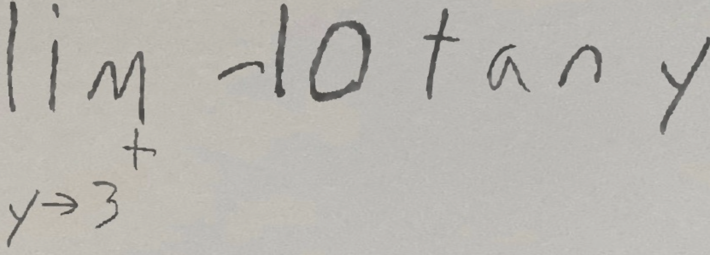
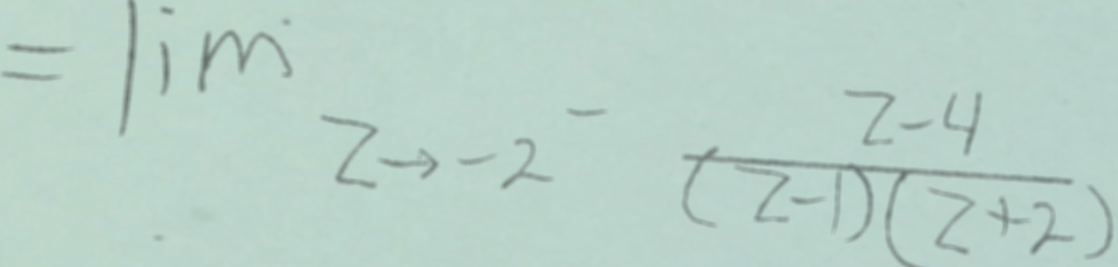
Results: Transcription
Normal
ER | ≤ 1 error | ≤ 2 errors
81%* | 90%* | 92%*
Outlier
*Given transcriptor scope of limits of fractions where the numerator and denominator are additions/subtractions of geometric functions or variables.
Notes:
Results: Transcription
Due to the limitations of libraries used to implement the transcriptor
The scope was limited to limits of fractions which could include geometric functions
The metric used was expression recognition defined as the # of correctly parsed expressions divided by the total number of expressions
Given the limited scope we achieved an ER of 81%
When we allowed one and two errors in the transcription this went up to 90% and 92% respectively
These errors can attributed to the incorrect segmentation of characters into the limit, numerator, and denominator
As we can in this example, most of the images follow a structure where the limit bounds are found below the limit and the numerator is completely above the fraction line
However, there exist outliers in the data set such as this one where the limit bounds are to the right of the limit at the parentheses in the denominator reach above the fraction line.
These outliers may explain the small difference between the ER with a 1 and 2 error tolerance
For the outliers it is much more likely that several characters get misclassified leading to an error of more than 2 characters

Slide 6
Conclusion
Despite poor performance, methodology could motivate future work with more computational power and other large OCR pre-trained detection models.
The transcriptor showed promise on its limited scope. Extensions include using a CNN to segment the characters into different elements of the equation.
Future work should evaluate detection and transcription together for actual use in automated grading
Notes:
Camila
Despite poor performance, methodology could motivate future work with more computational power and other large optical character recognition pre-trained detection models.
The transcriptor showed promise on its limited scope. Extensions include using a CNN to segment the characters into different elements of the equation.
Future work should evaluate detection and transcription together for actual use in automated grading

